Slide 1
Application of Machine Learning to Determine and Prevent a
Serious Aviation Safety Problem in the US - Runway Incursions
Team:
Abhinav Gupta, Atharva Joshi , Chahita Verma , Likhit Jha , Mino Cha , Ravneet Kaur , Shreyas Malewa
Faculty Advisors:
Najmedin Meshkati,
Ulf Hermjakob,
Yolanda Gil,
Daniel Scalese

Slide 2
INTRODUCTION
‘Air disasters are rare in the US, close calls are a different story’
- The New York Times (23rd August 2023)
The NYT article highlights a trend of incursions and near misses in the United States aviation industry.
While there haven't been major plane crashes for over a decade, close calls involving commercial airlines are occurring frequently, often due to human error and a shortage of air traffic controllers.
The number of near misses has doubled in the last decade, raising questions about the safety of the U.S. air travel system.
Direct action is needed to improve the situation. NASA maintains a database - ‘Aviation Safety Reporting System’ - that records incident reports of all runway/taxiway incursions since 1988. A treasure trove of untapped potential.

Slide 3
AIM
To analyze aviation incursion reports and determine the primary safety concerns and system fracture points leading to such situations with compelling data.
To improve aviation safety through the analysis of NASA’s Aviation Safety Reporting System (ASRS) incursion data of 45000+ reports..
To use Machine Learning and Natural Language Processing models to process data and extract useful statistics that can be used to make suggestions to the concerned authorities and effectively alleviate the ongoing crisis.
To setup preliminary foundation for development of an artificial intelligence model that can dynamically read new reports and provide valuable insights.

Slide 4
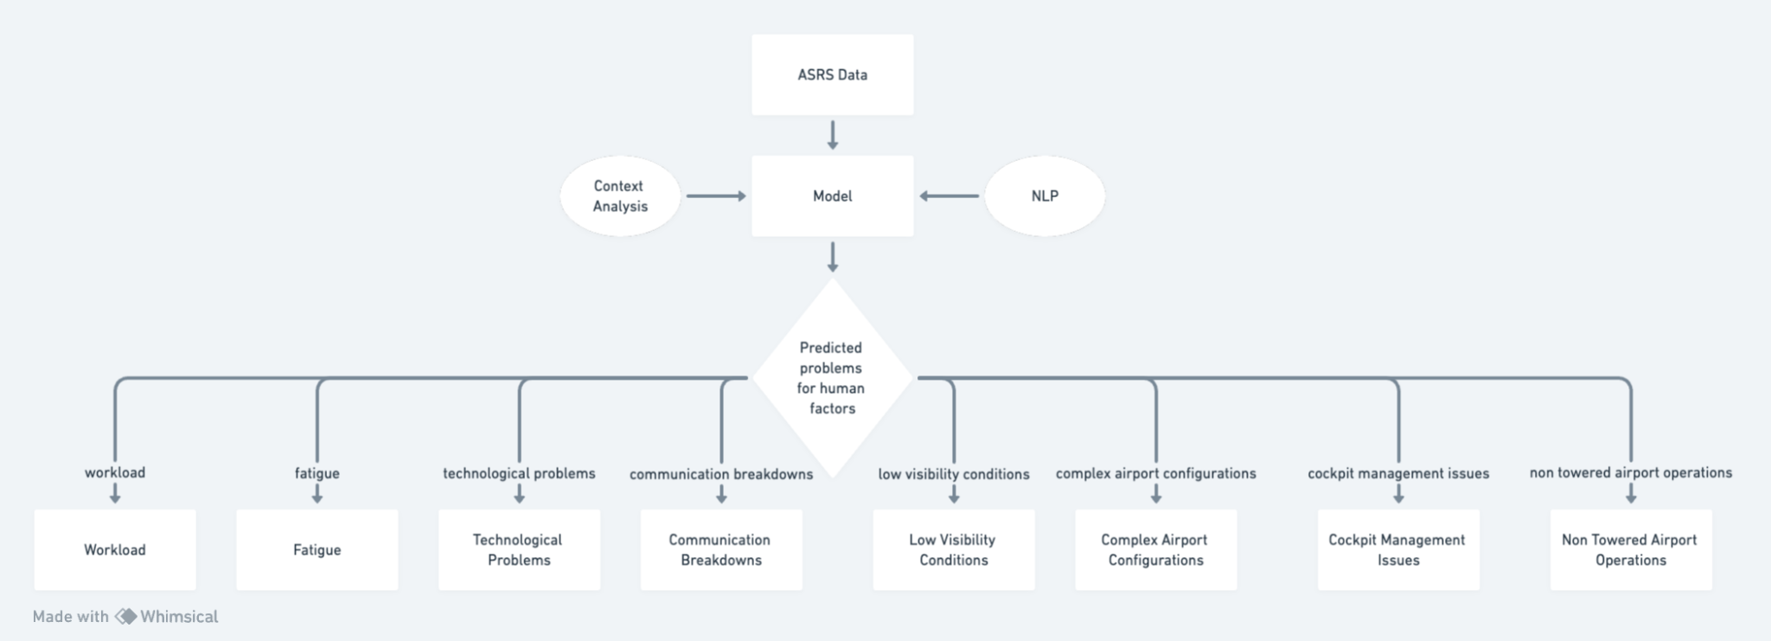
METHODS
Use Case Diagram Classifying Incursions Predicted by the Preliminary
Baseline Model based on Sub-Categories of Human Factors

Slide 5
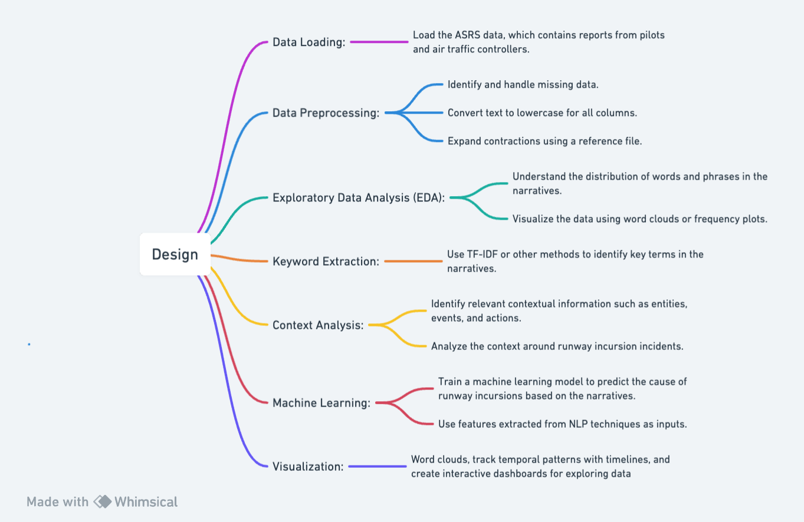
METHODS
Method Architecture Diagram

Slide 6
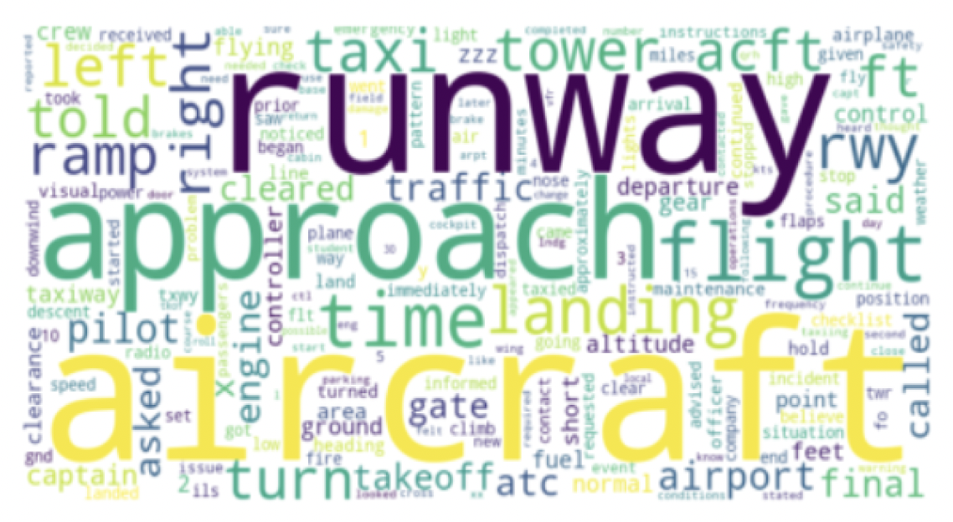
RESULTS
Word Cloud Representation displaying most occurring words in ‘Narrative’ column

Slide 7
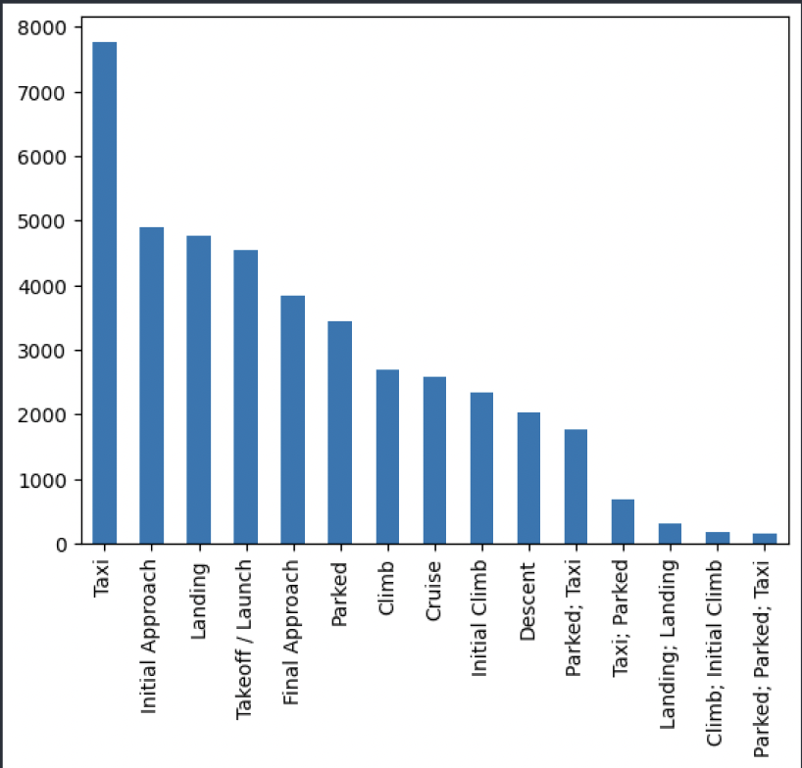
Bar Plot Representation of ‘Flight Phases’ when most number of Incursions happened

Slide 8
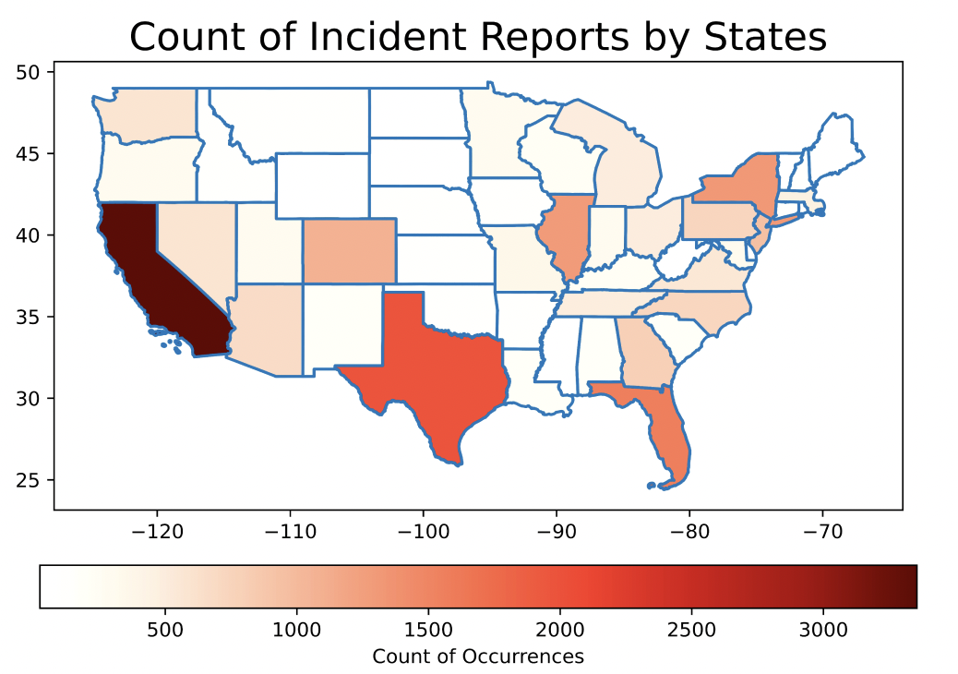
Heat Map Representation of collected ASRS reports based on ‘State Reference’

Slide 9
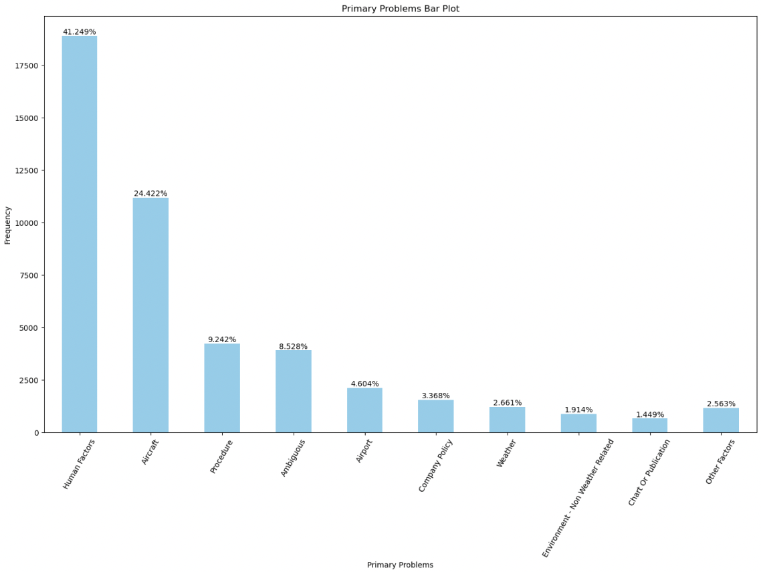
Bar Plot Representation of ‘Primary Problems’ leading to most incursions

Slide 10
CONCLUSION
From Results:
Words such as aircraft, runway, approach, landing, light, taxi, etc. occur more frequently
Incursion accidents mostly happen on-ground during taxi, initial approach or landing
CA, TX and FL have very high number of incursions
Human Factor and Aircraft Issues are the leading primary causes of most incursions
Next Steps:
Research, Design and Develop appropriate models to improve aviation safety
Focus and dig deeper into important features. E.g., Narrative, Flight Phases, Primary Problems, and Weather Environmental Factors
Continue studying the subject to enhance our data literacy on aviation runway through more articles about aviation safety concerns/incidents
Data wrangling: find and aggregate necessary data to improve our dataset. E.g., Annual number of flights in each state, by each airport, etc.

Slide 11
THANK YOU !!

